Slide 1
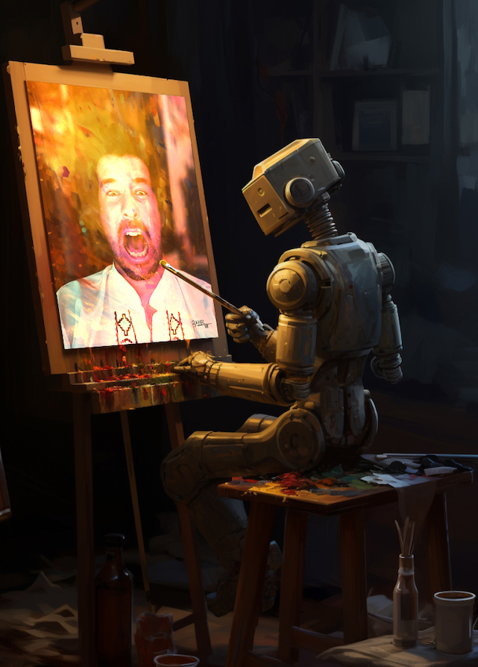
A Machine Learning Approach to Unmasking Art Forgery:
Detection and Analysis
by Kutay Ölmez
Supervised by Venera Adanova
Notes:
Art forgery is a prevalent issue in the art world, and detecting it is crucial for preserving the authenticity of artworks. This presentation will explore the significance of detecting art forgery and the application of machine learning in this domain.

Slide 2

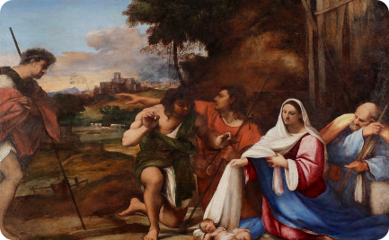
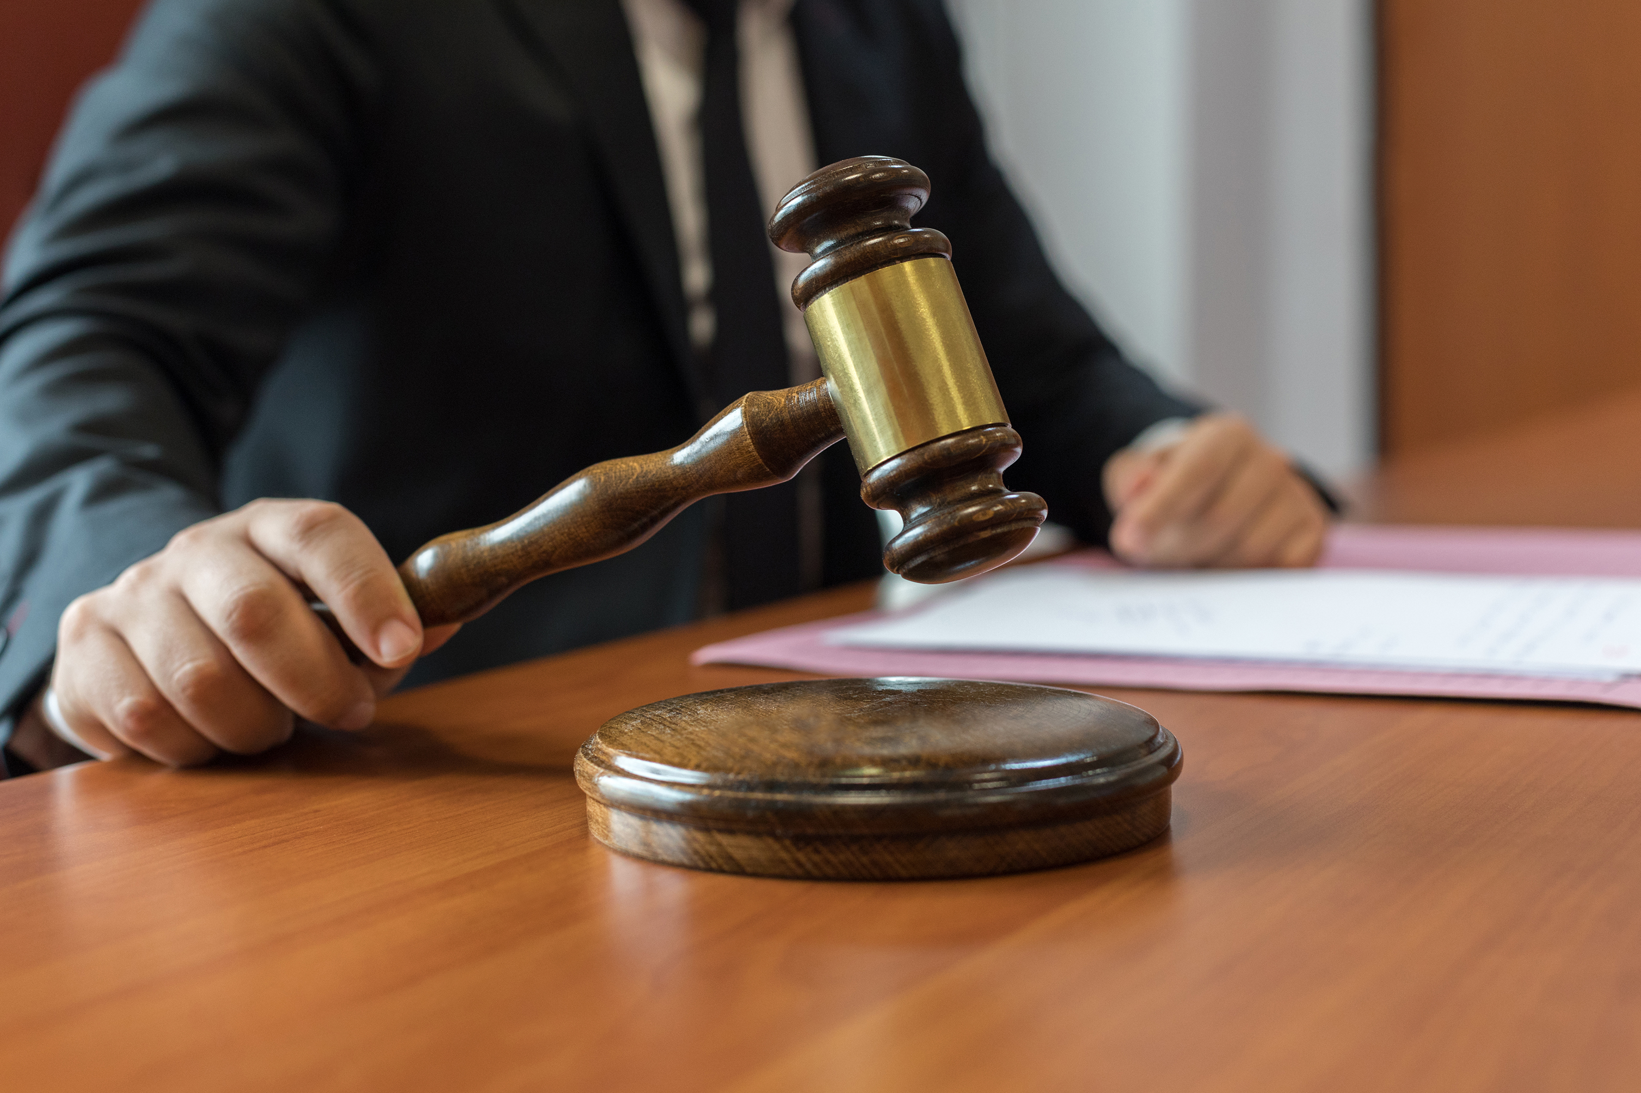
Importance of Detecting Art Forgery
Preserving Artistic Integrity
Protecting Artistic Heritage
Financial and Legal Implications
Detecting art forgery ensures that the artistic legacy and creativity of genuine artists remain intact, protecting their contributions to the art world.
Identification of forged artworks is essential for preserving the cultural heritage and historical significance of genuine art pieces.
Art forgery detection safeguards the art market and collectors from financial losses and legal entanglements arising from fake artworks.

Slide 3

Overview of Machine Learning in Art Forgery Detection
Algorithmic Analysis
Data Visualization
Pattern Recognition
Machine learning algorithms provide a systematic approach to analyze artistic styles, materials, and techniques for identifying anomalies.
Advanced data visualization techniques aid in the comparison of art features, enabling the differentiation between authentic and forged artwork.
Machine learning models excel in recognizing subtle patterns, enabling the identification of forged elements within artworks.

Slide 4

Literature Review
1
How AI Generate Images?
Exploring the context of image generation provides insights into evolving techniques and trends
2
Dataset Review
Dataset of both AI-generated and real artwork paintings, covering a variety of art movements and image generation techniques.
3
Art Forgery Detection
Evaluating different approaches with machine learning of the AI generated image detection

Slide 5
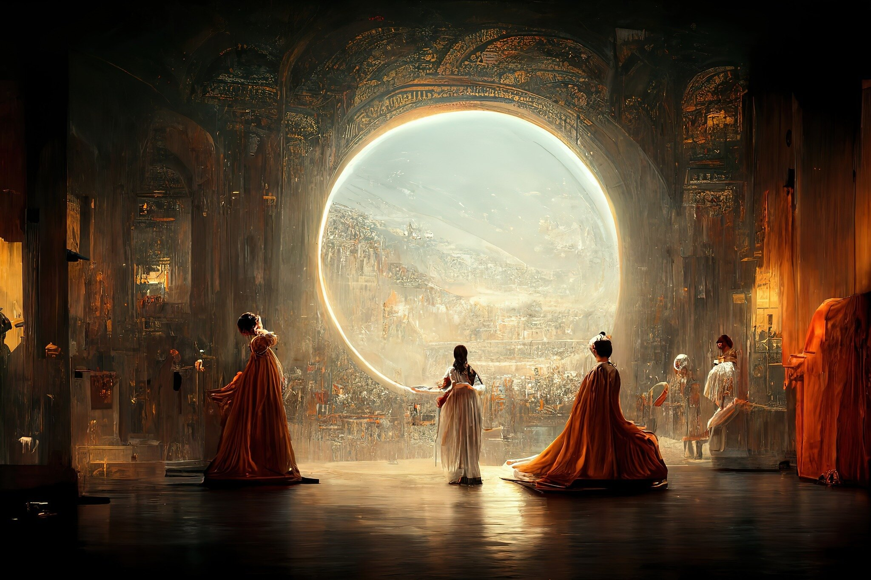
Data Collection
1
Why DeepFake Art Challenge Database?
2
Database Analysis
3
Data Preprocessing
It has both fake and real artwork paintings, it contains various art movements, and it divided according to 4 different generation techniques.
Analysis to examine the database in more detail, to identify categories that do not meet the objectives of the project, to identify deficiencies in file organisation
In the pre-processing stage, to eliminate the deficiencies identified in the analysis and to ensure the suitability of the data for training machine learning models.

Slide 6
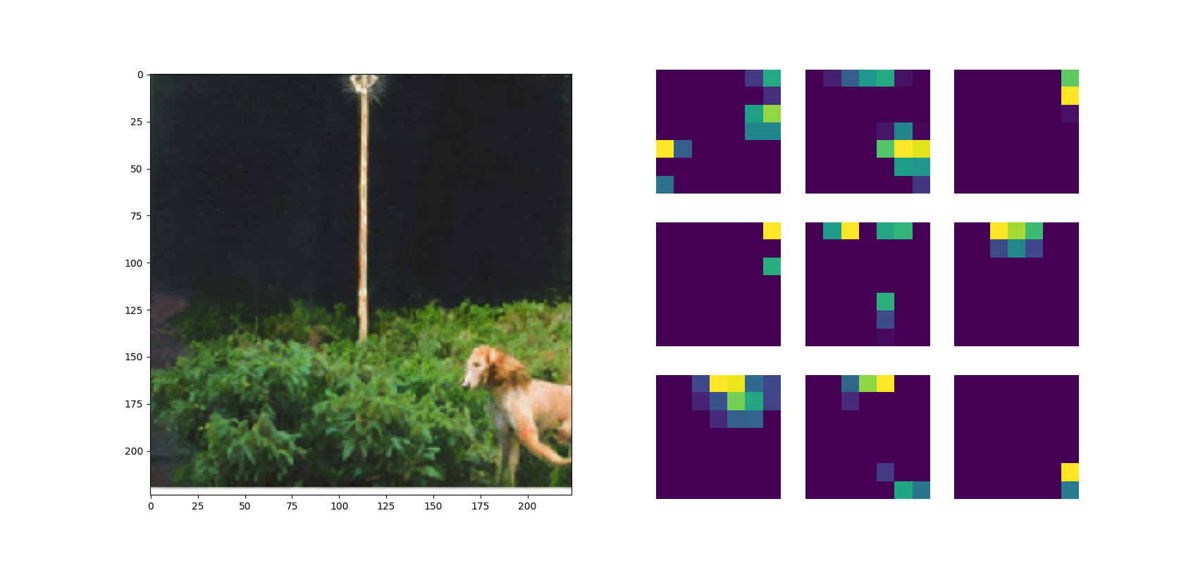
Feature Extraction
Aim
Why ResNet50 ?
Extraction of features from images is an important step in the project. This process is employed to derive meaning from AI-generated artworks and identify prominent features.
Represents is effectively utilized to extract complex features present in artworks. It provides higher performance and accuracy in examining artworks.

Slide 7



Training and Evaluation of Machine Learning Models
Spliting By Categories
Training Model
Performance Metrics
The objective is to observe the differences between training the model separately for each category and training the model by combining categories.
The data were already separated into test and train sets in the database. Logistic regression was used for the classification process after the data was scaled.
Evaluation of models using metrics like precision, recall, and F1 score to gauge their effectiveness in forgery detection.

Slide 8
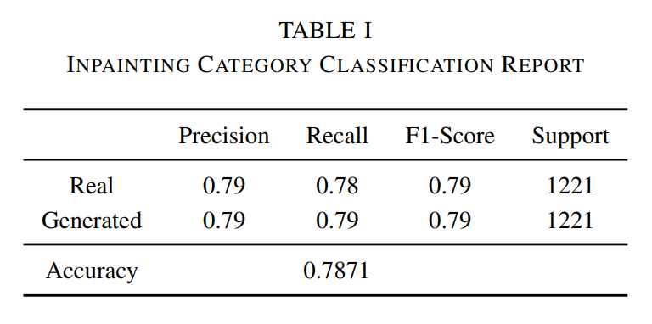
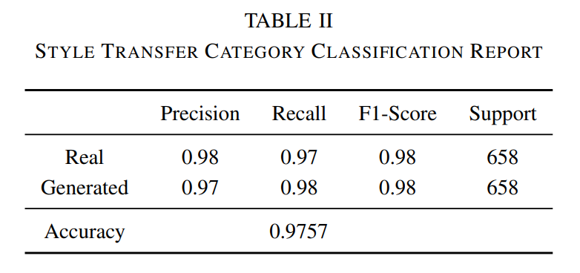
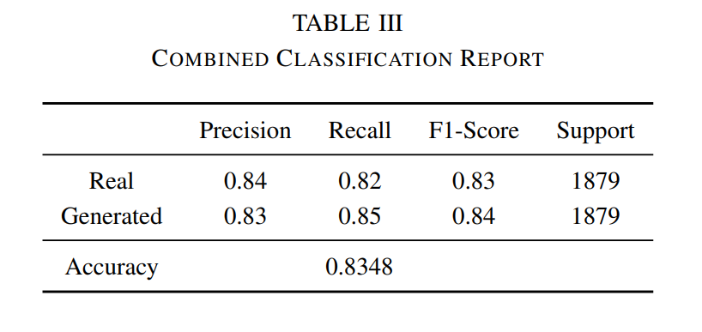
Results
Accuracy Evaluation
Performance Metrics Analysis
Assessment of the accuracy achieved by the machine learning models in detecting art forgeries.
Comprehensive analysis of precision, recall, and F1-Score metrics to evaluate the efficacy of the models.

Slide 9
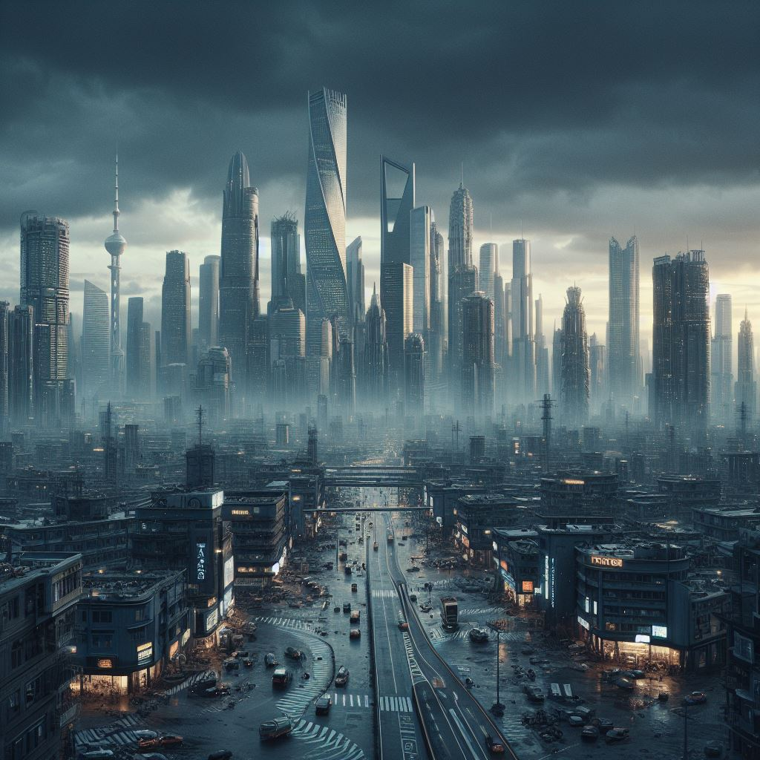
Future Improvements
Feature Extractor Layers
Hyperparameter Tuning
Classifier Model
Exploring various feature extractor layers within ResNet50 allows for a nuanced analysis of artwork. By selecting and fine-tuning specific layers, the model can focus on extracting more relevant and distinctive features, potentially enhancing its overall performance.
Hyperparameter tuning is pivotal in optimizing the model's performance. Adjusting parameters like learning rate, batch size, and regularization can fine-tune the model, leading to improved accuracy and robustness in understanding the intricate details of AI-generated artwork.
Experimenting with alternative classifier models introduces diversity in the feature recognition process. Utilizing classifiers beyond the standard ones may reveal novel patterns in the artwork data, potentially enhancing the model's ability to categorize and interpret various artistic styles and elements.

Slide 10
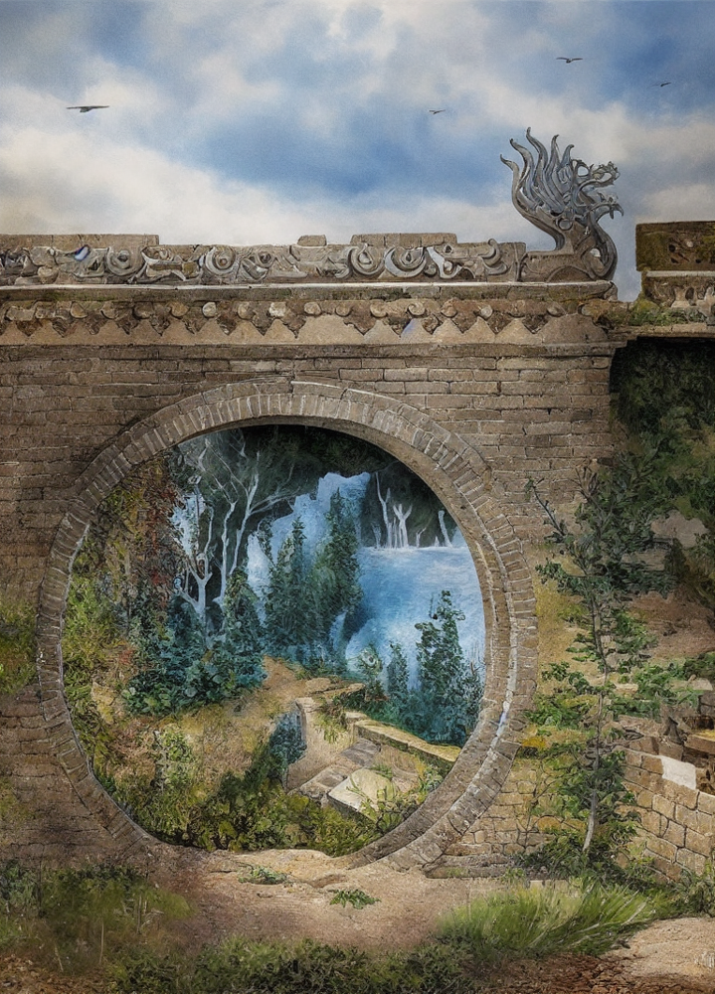
Conclusion
1
Current Situation
2
Continued Advancements
The success of our model in distinguishing real and AI-generated artworks highlights machine learning's potential in addressing authentication and copyright challenges in the art domain.
To prepare our study for real-world scenarios, ongoing improvements in the current approach, exploration of alternative methods, and increased resource allocation are essential for achieving even more robust and accurate results in future research.

Slide 11
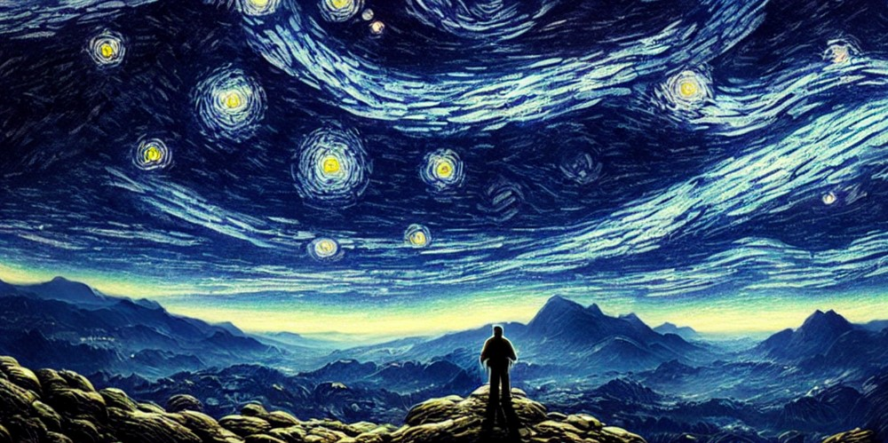
Thank You!
For Your Attention.

